Slide 1
Module 46: Deploying Assignment Manager
Siebel Core Developer and Technology School
Notes:
Time: Lecture: 25 – 35 minutes; labs: 20 minutes
Intent: To explain how to run Assignment Manager in batch mode, dynamic mode, and interactive mode.
Flow: Requirements for running Assignment Manager, different ways to invoke Assignment Manager, batch assignment, dynamic assignment, and interactive assignment.
Key Terms:
Batch assignment
Dynamic assignment
Assignment policies
Interactive assignment
Lock assignment
Please note: Faculty-specific notes are italicized.

Slide 2

Module Objectives
After completing this module you will be able to:
  Invoke Assignment Manager
Why you need to know:
  You need to enable your Siebel environment to support Assignment Manager
Notes:
Each objective and “why you need to know” should be stated aloud.

Slide 3


Requirements for Assignment Manager
Enable the Assignment Management component group
Notes:
Students learned how to enable component groups in the Server Administration module.

Slide 4
Three Ways to Invoke Assignment Manager
Batch Assignment
Dynamic Assignment
Interactive Assignment
Notes:
There is another assignment mode called Mobile Assignment. This allows assignment based on changes uploaded by mobile clients. Assignment Manager will assign objects after mobile client synchronization. It uploads assignment requests or any changes to objects and assignment rules. Since we have not covered remote clients yet, this type of assignment might lack context. You can mention it if anyone asks about Assignment Manager and remote clients.

Slide 5
Batch Assignment
Use to submit batches of objects for one-time assignment or reassignment
Implemented via server task
Business Scenarios
  Change assignment rules and modify existing objects that are already assigned
  Change Assignment Manager configuration using Siebel Tools
  Territory re-alignment
  Existing assignments are inaccurate
Notes:
Assignment Manager is designed to automatically assign objects to people. When someone creates a new account, for example, Assignment Manager assigns the account based on rules written for the account object. This is an example of dynamic assignment.
Batch mode is designed to assign also, but it is not an automatic process. It is a process that is started through server administration. Why would someone want to run Assignment Manager in batch mode? One example is after an initial data load; users might want to make assignments after a large data load. Another important reason to use Assignment Manager in batch mode is for testing. Users must thoroughly test Assignment Manager to make sure that their results are what they expect, and that all combinations of rules or criteria work together. Other examples are listed on the slide. You should talk about these.
The second sub-bullet point (“Change Assignment Manager configuration using Siebel Tools”) might need further discussion. If users add assignment objects using Siebel Tools, they must test the new objects in batch mode as well.

Slide 6
Batch Assignment Processing Flow
1. Invoke task
2. Evaluate rules for assignment object
BATCH
ASSIGNMENT
Released
Assignment
Rules
3. Assign candidate(s) to assignment object
Siebel
Database
Notes:
As learned in previous modules, Assignment Manager selects the best candidates and assigns them to the object based on the released assignment rules. This is what happens during batch assignment.

Slide 7
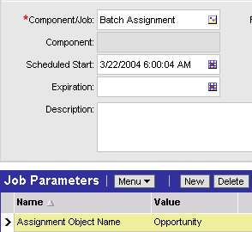
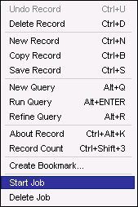
Invoking Batch Assignment
Select Site Map > Administration – Server Management > Jobs
1. Create new job and select Batch Assignment
2. Specify Assignment Object
3. Start Job
Notes:
You can specify conditions in the WHERE clause when you start the Batch Assignment task. That way, you can limit which items to assign and how many.

Slide 8
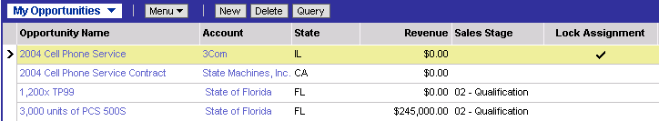
Lock Assignment
Set the Lock Assignment field on a record to prevent it from being considered for assignment by Batch Assignment
  Prevents selected records from being assigned or reassigned
  Can also be used for dynamic assignment
Lock Assignment checkbox
Notes:
The Lock Assignment Flag might be used if sales territories were realigned while sales representatives were already working on opportunities. Locking assignment on some existing records would prevent them from being reassigned to new sales reps based on the new assignment rules.
The Lock Assignment flag is not exclusively used by Batch Assignment.

Slide 9
Dynamic Assignment
Automatically invokes Assignment Manager to assign new or changed objects in real time
Business scenarios
  Whenever a Service Request is created, assign it to a service agent with the appropriate Product skill
  Whenever an Opportunity is created, assign it to the sales representative who handles that territory
Notes:
Dynamic assignment enables Assignment Manager to automatically assign objects when they are created or updated.

Slide 10
Dynamic Assignment Continued
Is implemented via:
  Assignment Policies
  Generate Triggers
  Workflow Monitor Agent
  Assignment Manager

Slide 11
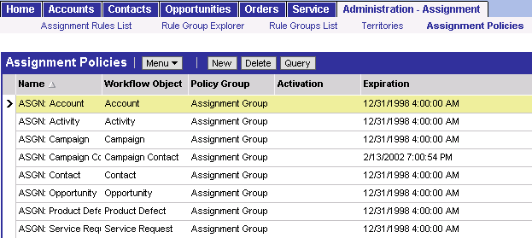
Assignment Policies
Specify which objects are to be assigned
Are expired by default
  Select Site Map > Administration – Assignment > Assignment Policies
  Remove the expiration date to activate policies
Notes:
Since Assignment Manager is presented after Siebel Workflow in the course, students are already be familiar with the concept of policies.
Assignment policies are specific to Assignment Manager and provided as part of the Siebel seed data.
Demonstrate how to access assignment policies by selecting Administration - Assignment > Assignment Policies.

Slide 12
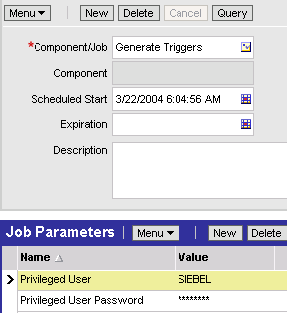
Generate Triggers
Is a server task that creates database triggers
  Builds triggers for all active Assignment Policies
Must be run after policies are activated
Requires a user name with privileges to add triggers to the database
Notes:
The Generate Triggers server component creates database triggers from workflow policies (presented in a previous module) and assignment policies (explained here).

Slide 13
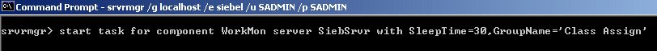
Workflow Monitor Agent
Start Workflow Monitor Agent and specify:
  Group Name (the group of Assignment Policies you activated)
  Sleep Time (interval in seconds between iterations)
Component alias
Siebel Server
Parameters
Notes:
Workflow was presented prior to Assignment Manager in the course, so you are already familiar with the Workflow Monitor Agent task. It uses policies to monitor changes for Assignment Manager. Policies are presented on the next slide.
Siebel applications include predefined assignment policies for each of the predefined assignment objects. Users can use these predefined assignment policies or create new assignment policies for dynamic assignments.
Each Workflow Monitor Agent can monitor one or more assignment policies. Users can use a single Workflow Monitor Agent to monitor all assignment policies by placing all assignment policies in the same workflow group (the predefined assignment policies are defined this way). Users can also place the assignment policies in separate workflow groups and dedicate Workflow Monitor Agents for each workflow group. For example, for this task, users indicate in the Group parameter which group they want to monitor.

Slide 14
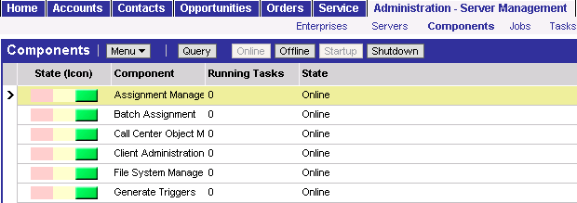
Assignment Manager
Is invoked by Workflow Monitor Agent
  Assignment Manager server component must be online
Performs the assignment of data to candidates
Notes:
Assignment Manager is a combined process, using the rules that the users created along with the Workflow Monitor Agent server component.

Slide 15
Dynamic Assignment Process Flow
Creates Triggers (run once)
1. Create account
S_ESCL_REQ
GENERATE
TRIGGERS
Siebel
Database
2. Trigger writes record
5. Makes assignment
ASSIGNMENT MANAGER
WORKFLOW
MONITOR AGENT
3. Workflow Monitor Agent monitors table for changes and when detected, invokes Assignment Manager
4. Evaluates Assignment Rules
Notes:
With dynamic assignment, Assignment Manager is invoked internally within Workflow Monitor Agent.
When a trigger fires as a result of a database insert or update, a record is written to the table S_ESCL_REQ. This table was described earlier in the Workflow modules. Workflow Monitor Agent monitors this table for changes in the database. It also maintains this table by deleting records once they have been processed by Workflow Monitor Agent.

Slide 16
Interactive Assignment
Use to assign candidates in real time
  Enabled for Service Request and Activity assignment objects
Implemented via user interaction and tasks on server
  User makes assignment from a generated list of candidates
Business scenarios
  A customer service representative receives a call and creates a new service request, then clicks “Assign” to find the right person to work on that service request
  A field service supervisor wants to find the right person to work on a repair Activity, and uses Interactive Assignment to obtain a list of people with the right skills to perform the repair
Notes:
Navigate to My Team’s Service Requests and My Team’s Activities and show the students the Assign option in the Menu button. If the record is not available for assignment, the Assign menu selection will be grayed out.
If you want to demo this, make sure that you are connected to a server and that the assignment components are running.

Slide 17
Interactive Assignment Flow
1. Request assignment
2. Start Assignment Manager thread
Select Assign
for
Service Request
SERVER REQUEST
BROKER
ASSIGNMENT
MANAGER
3. Send ranked list of candidates to user
4. User selects candidate for assignment
List of candidates
for assignment
SERVER REQUEST
BROKER
SERVER REQUEST
BROKER
5. Send selected candidate
ASSIGNMENT
MANAGER
Siebel
Database
6. Assign candidate
Notes:
You might want to set up a demo of interactive assignment.

Slide 18
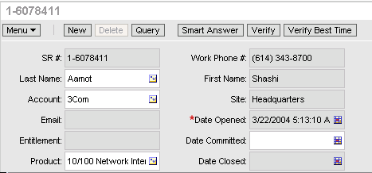
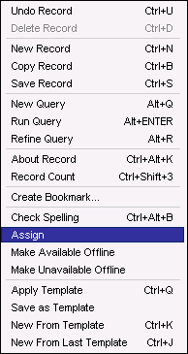
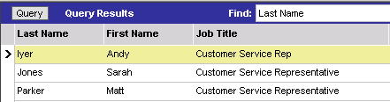
Invoking Interactive Assignment
Make the assignment by selecting from a list of qualified candidates
1. Select the work to be assigned
2. Click menu button and select Assign
3. Select employee and click Assign
Notes:
If an object is available for interactive assignment, (such as service requests and activities), the Assign action will be available for selection when clicking the Menu button.

Slide 19
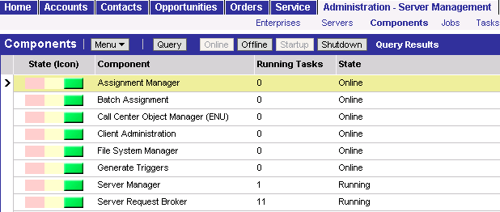
Requirements for Interactive Assignment
Verify that Assignment Manager is online and Server Request Broker is running
Performs Assignment
Brokers client requests
Notes:
Be prepared to talk about what to do if the component is not online.
Users should verify that the Assignment Manager component group is enabled. When they enable a component group, the Siebel Server must be stopped and then restarted for the change to go into effect.

Slide 20
Summary
This module showed you how to:
  Invoke Assignment Manager
Notes:
Review Question: What are the three ways to run Assignment Manager?
Answer: Batch, Dynamic and Interactive
Review Question: For what mode are database triggers required?
Answer: Dynamic Assignment

Slide 21
Lab
In the lab you will:
  Execute the Service Request by Product Line assignment rule in dynamic mode
  Inspect log files
Notes:
See the detailed lab instructions.

